Slide 1
Year 2 Reading Meeting

Slide 4
The National curriculum for English aims to ensure that all pupils:
Read easily and fluently with good understanding
Develop the habit of reading widely and often, for both pleasure and for information
Acquire a wide vocabulary, an understanding of grammar, spoken language and writing

Slide 5
What does reading look like in Year 2?
In English lessons we use a variety of rich texts to engage the children with high quality models from books. For example: this half term the children have compared different versions of Little Red Riding Hood and have used these to inspire their writing.

Slide 6
During the English lesson:
Whole class sharing of the story ( it won’t necessarily be the whole book, it might be just the front cover or a few pages).
Discussion is generated from the sharing of the text ( often using talk partners)
As the children develop confidence with their independent reading they will then teach them different comprehension reading skills e.g: answering comprehension questions, predicting the ending, inferring about a character, likes dislikes, linking to books they have read before, ordering the story…

Slide 7
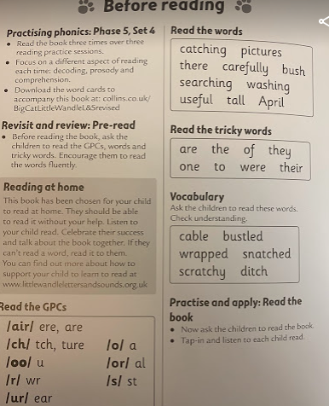
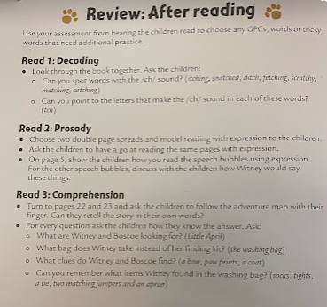
The three elements of reading
Decoding
Prosody
Comprehension

Slide 8
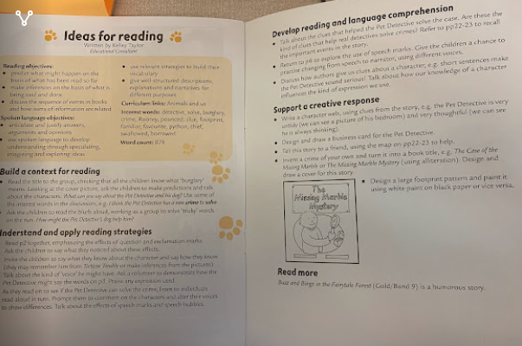
Supporting the different needs of the children
Daily phonics is currently continuing in year 2
Once the children are secure with their phonic knowledge and reading every word in their book fluently, they will progress to the Collins Big Cat books from colour band purple onwards. We will then assess them and move them to the next colour band when we think they are able to answer the comprehension questions and infer meaning from the text.

Slide 9
How often does a child read to a member of staff?
Every child reads to an adult 3 x per week
The children who are developing their fluency and learning to decode will read to an adult more than this. This will not always be recorded in their reading diary as it may be reading to a trained volunteer

Slide 10
Feeding back to parents about a child’s reading
Your child should have a slip of paper informing you of the focus of the reading sessions or a written comment
Parents evening
Written report at the end of year
If the class teacher has a concern they will talk to you about it

Slide 11
Helping with Reading at home
Parents/carers have an important role in practising fluency with their children. This is why children are asked to read the same book again as it develops their fluency. This is an important aspect of reading in Year 2.
Once the children are off Little Wandle and are reading fluently, the book that they take home will be different to the book they read in class.

Slide 12
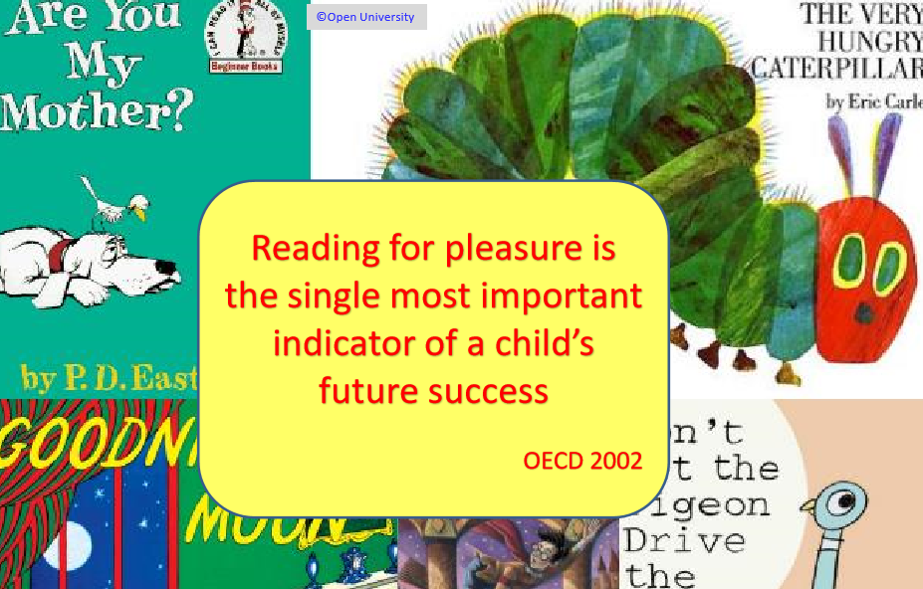

Slide 13
Reading for pleasure
International evidence demonstrates that reading for pleasure:
increases attainment in literacy and numeracy (e.g. Sullivan and Brown, 2013)
improves general knowledge and vocabulary (e.g. Clark and Rumbold, 2006)
encourages imagination, empathy and mindfulness of others (e.g. Kidd & Costano, 2013)

Slide 15
‘The more that you read, the more things you will know. The more that you learn, the more places you’ll go’
-Dr. Suess

